Slide 1
Deprecated Functions Overview
AVCDL-Implementation-6.1
Charles Wilson
Staff Product Cybersecurity Architect
version 4
2026-03-05
Notes:
Script:
I'm Charles Wilson, staff product cybersecurity architect at Torc Robotics.
This presentation will cover an overview of Deprecated Function handling.

Slide 2
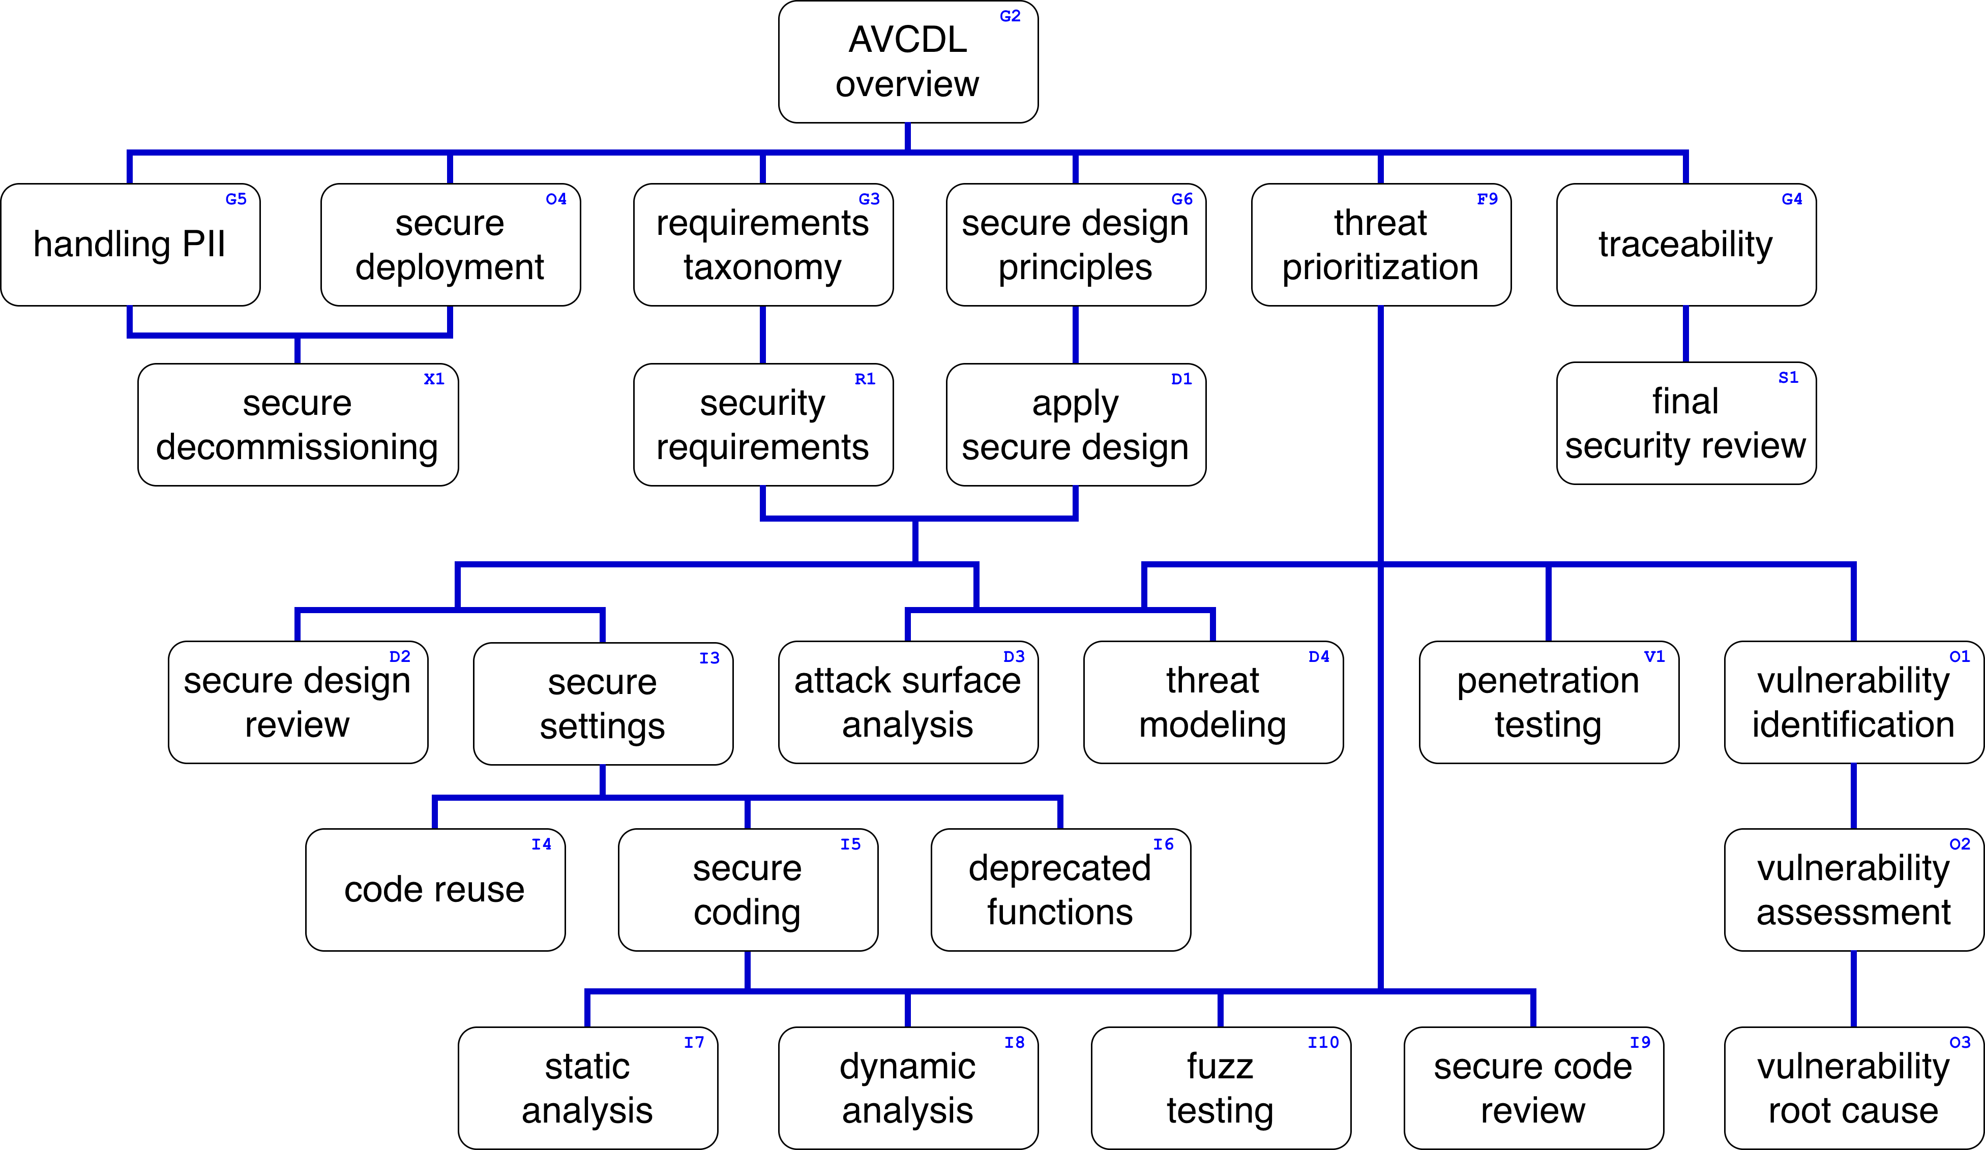
Training Path
Notes:
Script:
This diagram shows the overall AVCDL training path.
If you're taking this training, it's assumed that you've already completed the AVCDL Overview training,
and additionally, that you've completed the
Requirements Taxonomy
Security Requirements
Secure Design Principles
Apply Secure Design
and
Secure Settings
trainings.
This training will cover an overview of how to handle Deprecated Functions.

Slide 3
Introduction
Notes:
Script:
Within the context of product cybersecurity, deprecated functions may well be the least appreciated area that we take into consideration.
If you look at things like attack surface analysis, or even secure code review, it's obvious to most people that these are areas that we should be giving attention to.
When it comes to things like deprecated functions, however, we are met with a level of resistance that we don't see in many other places.
Traditionally, the software development approach has been one of, “if it isn't broken, don't fix it.”
Simply because something works, doesn't mean it has no vulnerabilities.
Let's consider a good example where we have something that's traditional and has been known to work and yet is not what we would consider by today's standards to be safe.
[break]
This is the classic straight razor.
It's been used for shaving for thousands of years.
It does the job beautifully when it is in the hands of someone who has mastered the technique of utilizing it.
When it's in the hands of someone who is not well versed, it can lead to all sorts of unfortunate situations.
Worse yet are outcomes, when in the hands of someone who has malicious intent.
We looked at this problem and came up with an alternative.
[break]
Which we see a representation of here.
It does the same work that the straight razor does.
This is, of course, the oscillating electric razor.
And It operates in a way which is unquestionably safer.
Additionally, it’s easier to master.
So, how does this relate to software functions.
We can have a function that was created decades ago that we still use.
It does its task as expected, but it’s been determined that it has a vulnerability.
If the vulnerability is leveraged, it may become a threat to the system.
It's not that the function isn't doing its task.
It's that the function can be misused or abused, leading to the compromise of the system’s cybersecurity.
What we would like to do is to replace these functions with ones which are not subject to the vulnerabilities of the current ones.

Slide 4
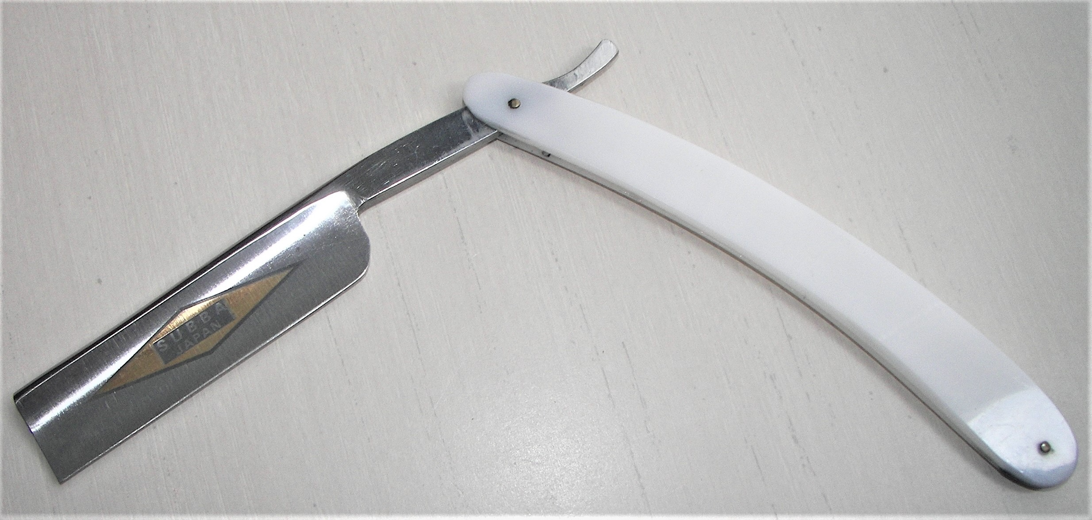
Introduction *
* Square edge razor (link in references)
Notes:
Script:
Within the context of product cybersecurity, deprecated functions may well be the least appreciated area that we take into consideration.
If you look at things like attack surface analysis, or even secure code review, it's obvious to most people that these are areas that we should be giving attention to.
When it comes to things like deprecated functions, however, we are met with a level of resistance that we don't see in many other places.
Traditionally, the software development approach has been one of, “if it isn't broken, don't fix it.”
Simply because something works, doesn't mean it has no vulnerabilities.
Let's consider a good example where we have something that's traditional and has been known to work and yet is not what we would consider by today's standards to be safe.
[break]
This is the classic straight razor.
It's been used for shaving for thousands of years.
It does the job beautifully when it is in the hands of someone who has mastered the technique of utilizing it.
When it's in the hands of someone who is not well versed, it can lead to all sorts of unfortunate situations.
Worse yet are outcomes, when in the hands of someone who has malicious intent.
We looked at this problem and came up with an alternative.
[break]
Which we see a representation of here.
It does the same work that the straight razor does.
This is, of course, the oscillating electric razor.
And It operates in a way which is unquestionably safer.
Additionally, it’s easier to master.
So, how does this relate to software functions.
We can have a function that was created decades ago that we still use.
It does its task as expected, but it’s been determined that it has a vulnerability.
If the vulnerability is leveraged, it may become a threat to the system.
It's not that the function isn't doing its task.
It's that the function can be misused or abused, leading to the compromise of the system’s cybersecurity.
What we would like to do is to replace these functions with ones which are not subject to the vulnerabilities of the current ones.

Slide 5
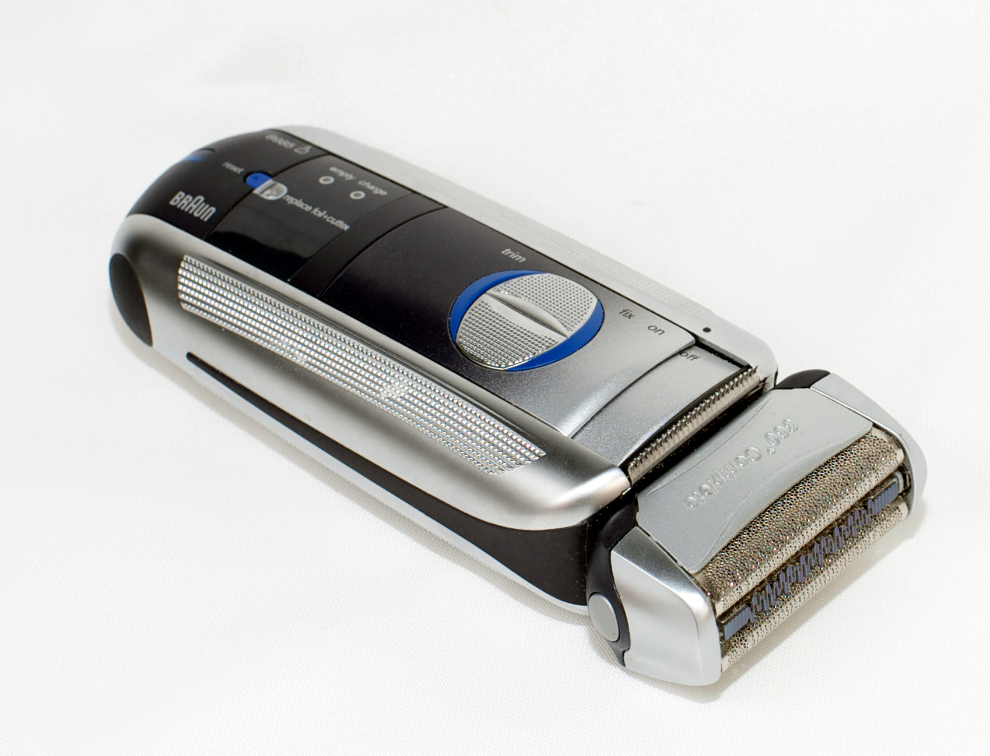
Introduction *
* Oscillating electric razor (link in references)
Notes:
Script:
Within the context of product cybersecurity, deprecated functions may well be the least appreciated area that we take into consideration.
If you look at things like attack surface analysis, or even secure code review, it's obvious to most people that these are areas that we should be giving attention to.
When it comes to things like deprecated functions, however, we are met with a level of resistance that we don't see in many other places.
Traditionally, the software development approach has been one of, “if it isn't broken, don't fix it.”
Simply because something works, doesn't mean it has no vulnerabilities.
Let's consider a good example where we have something that's traditional and has been known to work and yet is not what we would consider by today's standards to be safe.
[break]
This is the classic straight razor.
It's been used for shaving for thousands of years.
It does the job beautifully when it is in the hands of someone who has mastered the technique of utilizing it.
When it's in the hands of someone who is not well versed, it can lead to all sorts of unfortunate situations.
Worse yet are outcomes, when in the hands of someone who has malicious intent.
We looked at this problem and came up with an alternative.
[break]
Which we see a representation of here.
It does the same work that the straight razor does.
This is, of course, the oscillating electric razor.
And It operates in a way which is unquestionably safer.
Additionally, it’s easier to master.
So, how does this relate to software functions.
We can have a function that was created decades ago that we still use.
It does its task as expected, but it’s been determined that it has a vulnerability.
If the vulnerability is leveraged, it may become a threat to the system.
It's not that the function isn't doing its task.
It's that the function can be misused or abused, leading to the compromise of the system’s cybersecurity.
What we would like to do is to replace these functions with ones which are not subject to the vulnerabilities of the current ones.

Slide 6
Workflow
Notes:
Script:
With this motivating example out of the way, let’s look at the workflow involved in the handling of deprecated functions.

Slide 7
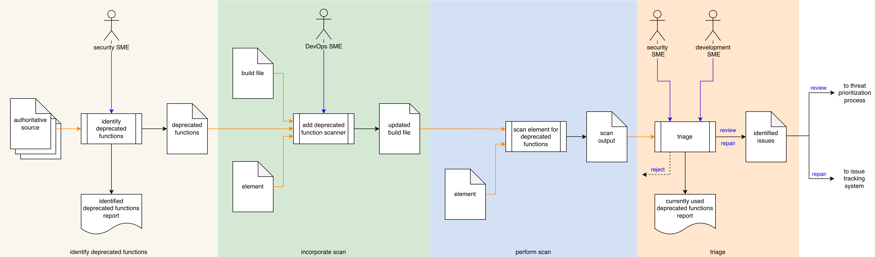
Process Workflow
Notes:
Script:
The workflow for performing the deprecated function handling process is broken down into four discrete activities.
These are:
• identifying the deprecated functions
• incorporating the scan
• performing the scan
and finally
• conducting a triage of the issues identified by the scan

Slide 8
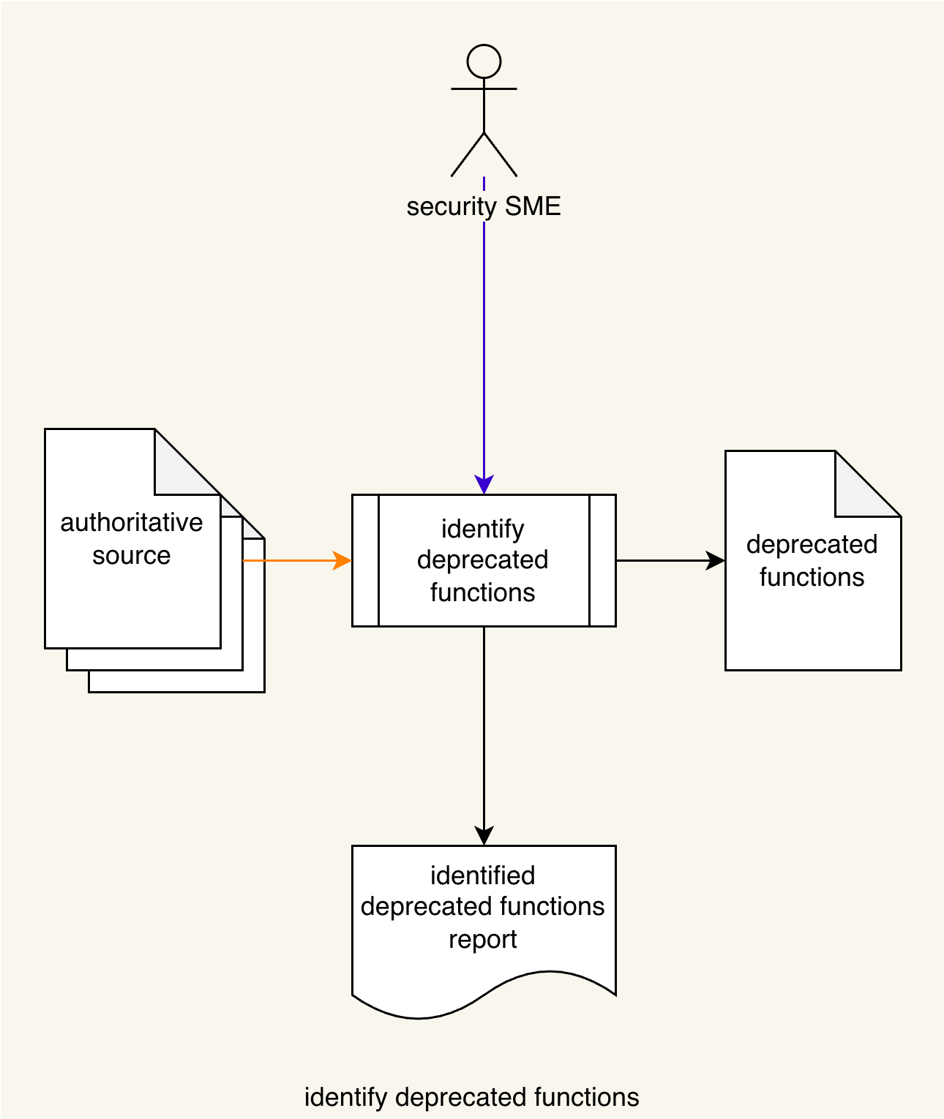
Identify Functions
Notes:
Script:
The workflow for performing the deprecated function handling process is broken down into four discrete activities.
These are:
• identifying the deprecated functions
• incorporating the scan
• performing the scan
and finally
• conducting a triage of the issues identified by the scan

Slide 9
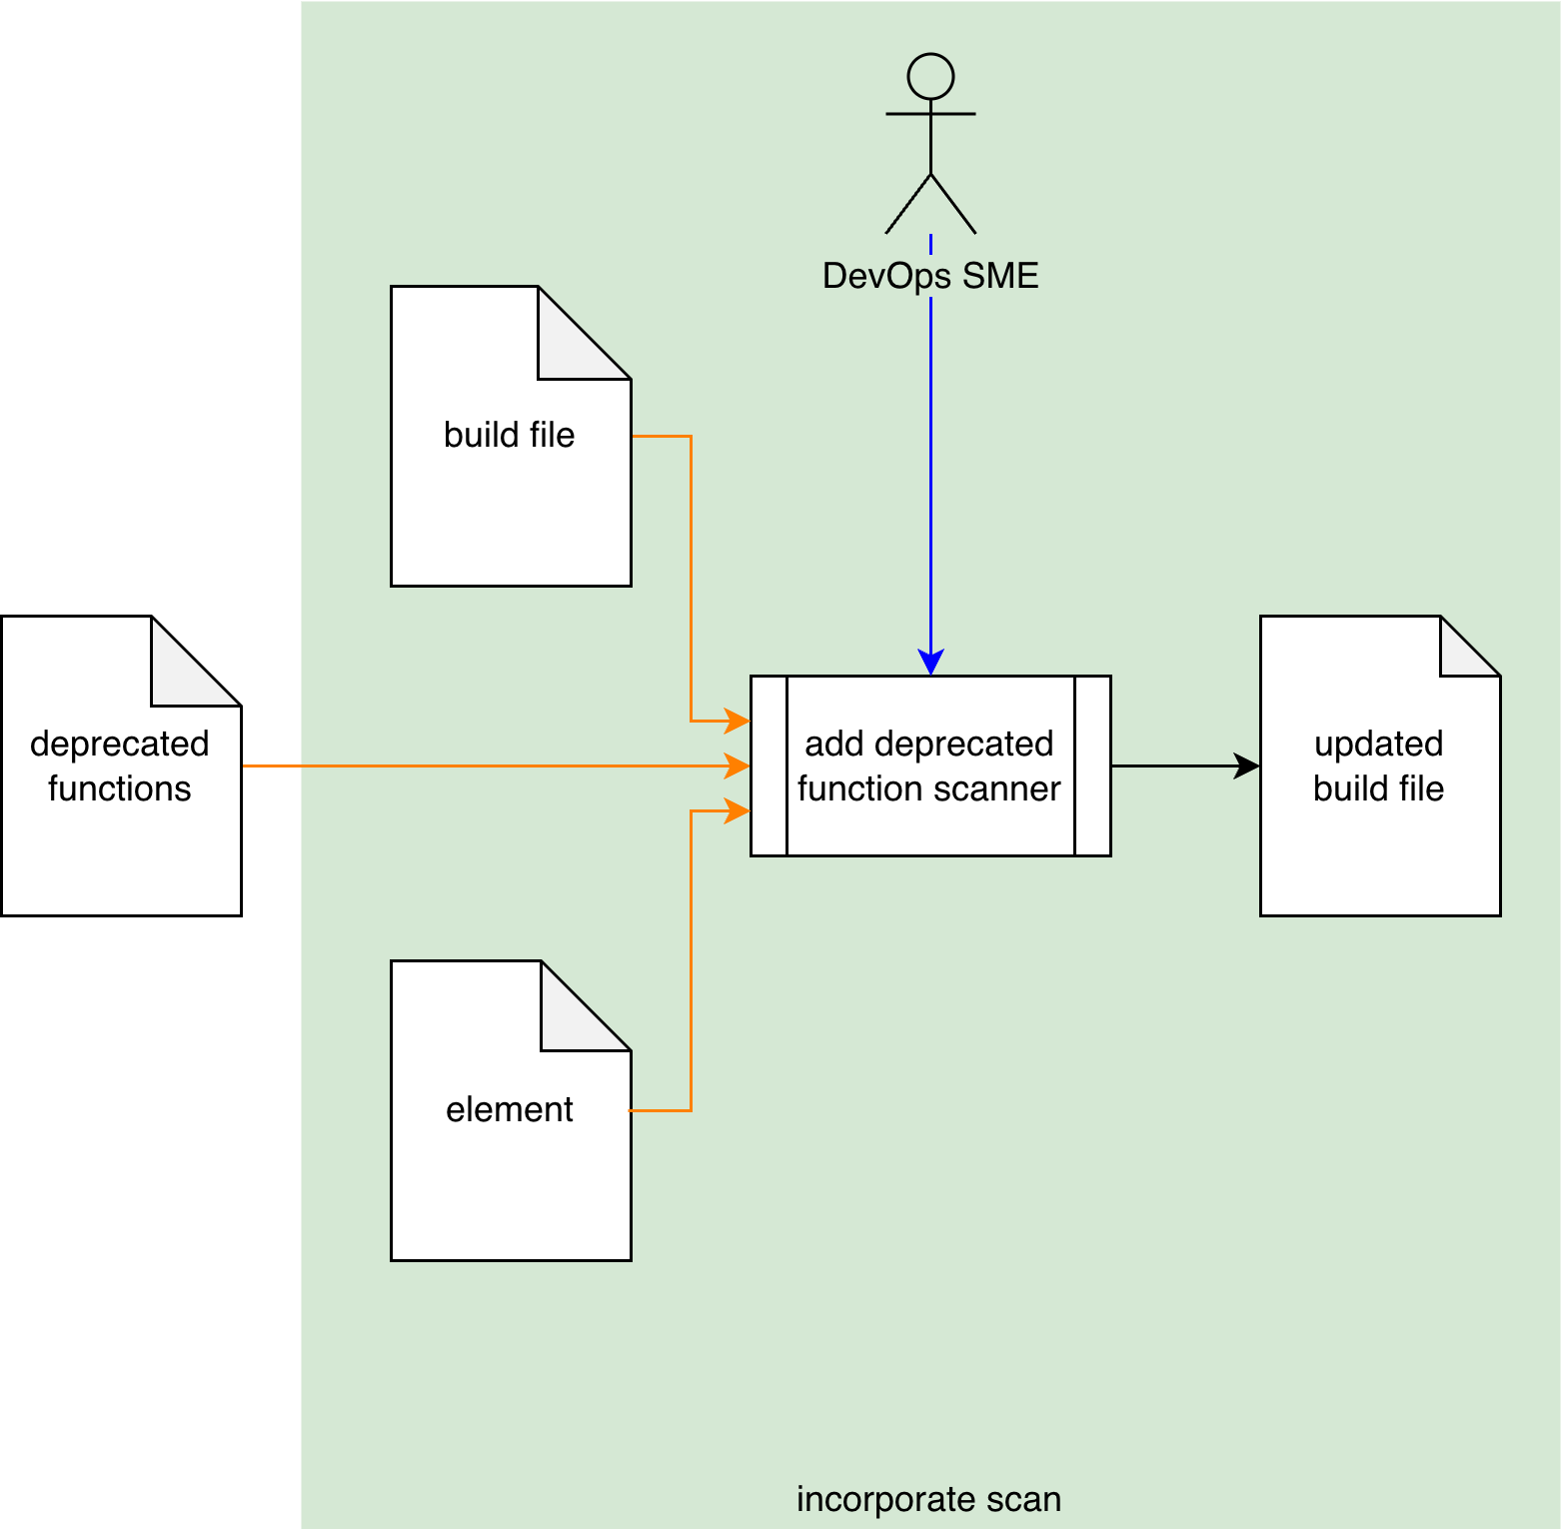
Incorporate Scan
Notes:
Script:
The workflow for performing the deprecated function handling process is broken down into four discrete activities.
These are:
• identifying the deprecated functions
• incorporating the scan
• performing the scan
and finally
• conducting a triage of the issues identified by the scan

Slide 10
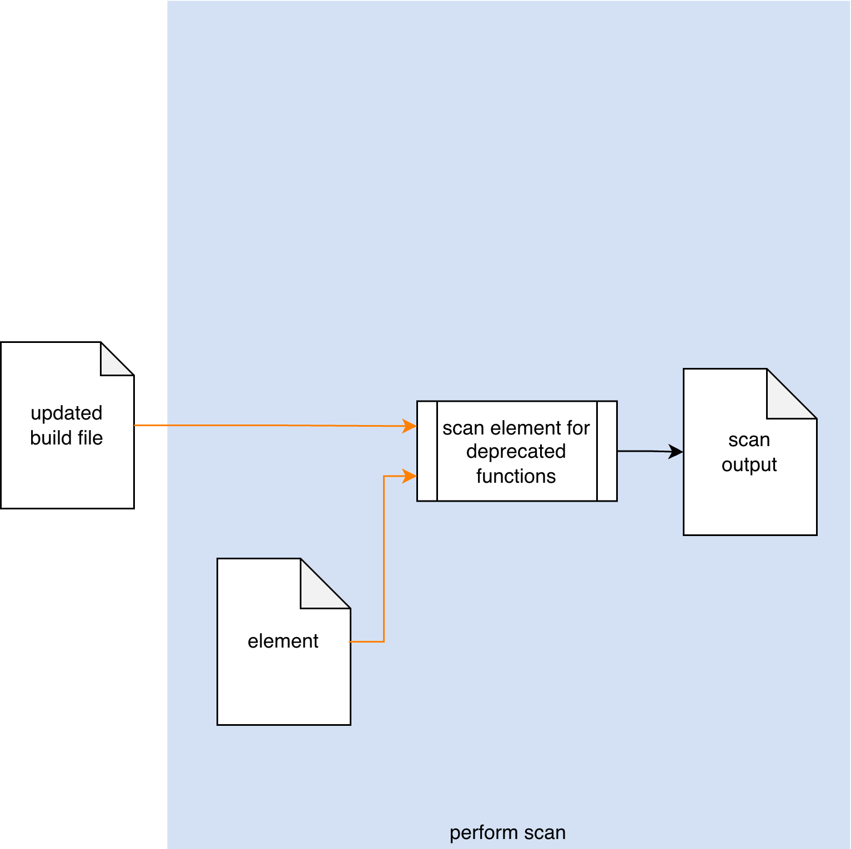
Perform Scan
Notes:
Script:
The workflow for performing the deprecated function handling process is broken down into four discrete activities.
These are:
• identifying the deprecated functions
• incorporating the scan
• performing the scan
and finally
• conducting a triage of the issues identified by the scan

Slide 11
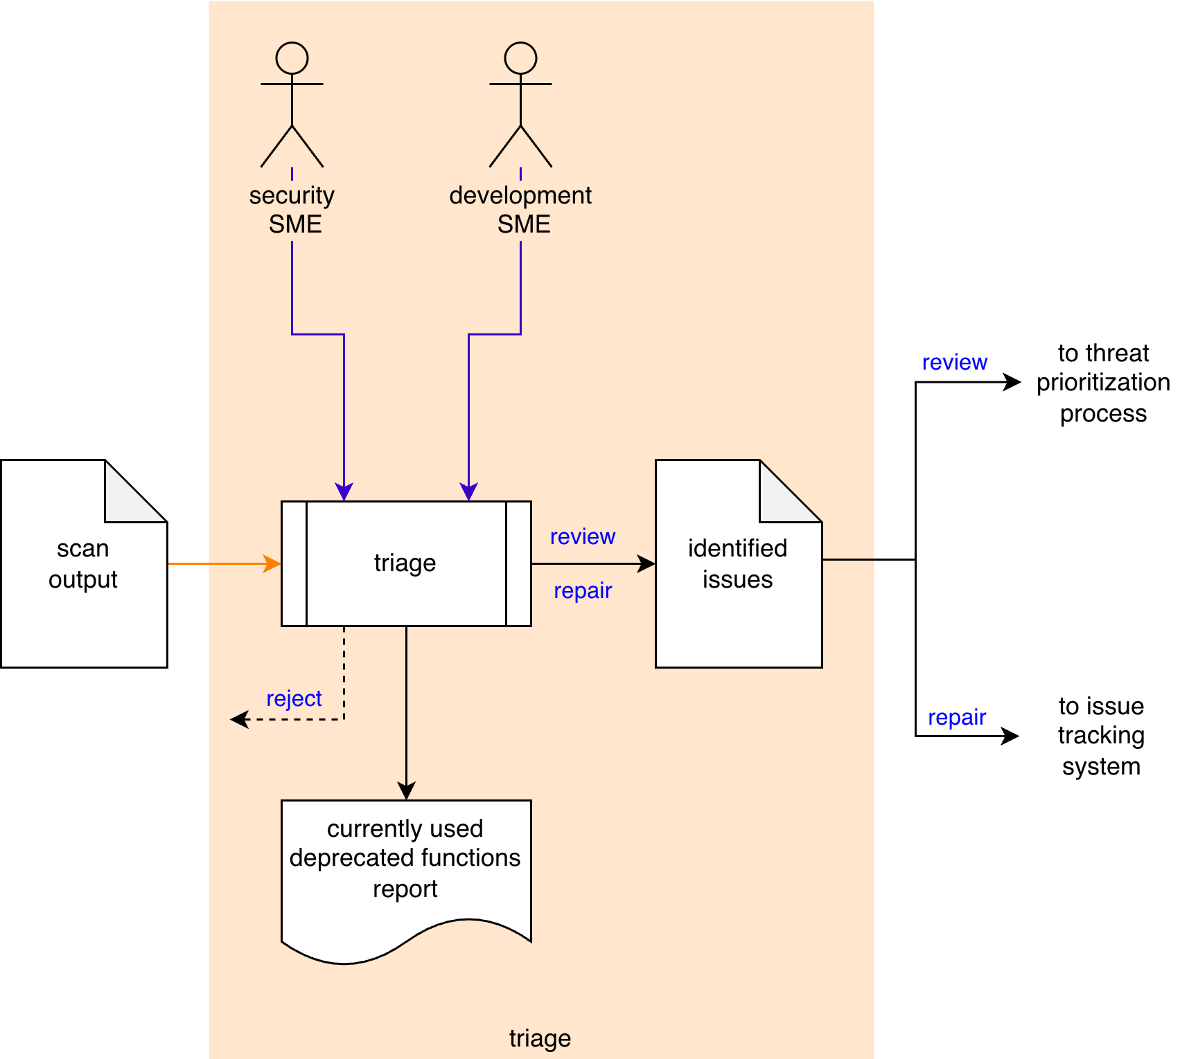
Triage
Notes:
Script:
The workflow for performing the deprecated function handling process is broken down into four discrete activities.
These are:
• identifying the deprecated functions
• incorporating the scan
• performing the scan
and finally
• conducting a triage of the issues identified by the scan

Slide 12
Activities
Notes:
Script:
Let's now turn our attention to each of these activities and get into more detail.

Slide 13
Identify Functions
Single language
Single platform
Notes:
Script:
The first activity in the deprecated functions process is that of identifying the deprecated functions themselves.
[pause]
The cybersecurity SME, who will look at
[pause]
the authoritative sources, and
[pause]
identify the deprecated functions called out in them.
These will be compiled into a deprecated functions list.
From that list,
[pause]
an identified deprecated functions report will be created.
When doing this, it's Important that the SME focus on
[pause]
a single language
[pause]
targeting a single platform.
This allows better management of how we're going to handle the deprecated functions, and if things change over time, that's going to be a lot simpler to track.

Slide 14
Incorporate Scan
Tooling
Dependencies
Notes:
Script:
The second activity in The second activity in the deprecated functions handling process is that of incorporating the scan into the build system.
[pause]
The DevOps SME takes
[pause]
the deprecated function list,
[pause]
the element to be scanned, and
[pause]
the build file.
[pause]
And makes the changes necessary to the build file to enable scanning.
And the result of this is
[pause]
an updated build file.
[pause]
There are two things that we need to consider.
[pause]
The first is the tooling used.
The mechanism used to perform the scan could be anything from a piece of standard software that's already in use, to simple regular expression tools.
Our second consideration is
[pause]
that of dependencies.
We don't want to waste time scanning code which we have no control over.

Slide 15
Perform Scan
Possibly manual
Notes:
Script:
The third activity in the deprecated functions handling process is that of performing the scan.
[pause]
The updated build file is going to invoke the tool used to take
[pause]
the element under consideration
[pause]
and scan for deprecated functions.
This will yield
[pause]
a scan output file.
Ideally this be done within the context of the CI/CD pipeline and without manual intervention
Now, It is possible to do this manually.
This is true with all automation.
We don't have automation until we can perform the task by hand.
And so, just because we see these activities which don't show an explicit actor, that doesn't mean that it is not possible for an actor to invoke the tooling that has been set up in order to perform this particular task.

Slide 16
Triage
File issues immediately
Tool false positives
Notes:
Script:
The final activity in the deprecated function handling process, as with so many AVCDL processes, is that of triage.
[pause]
The cybersecurity SME and
[pause]
the development SME take
[pause]
the scan output
[pause]
and triage it.
Any deprecated functions correctly identified will be added to
[pause]
an identified issues list and passed along to be addressed.
[pause]
Finally, a currently used deprecated functions report will be produced.
[pause]
There are two things we want to keep in mind here.
[pause]
The first is that the Identified issues may be filed immediately if they are in obvious need of correction.
Only those issues requiring additional review need go to the threat prioritization process.
Second, if we have
[pause]
tool false positives, where the scanner is identifying functions inappropriately, those issues should be rejected, and either the source or scoping of the scan needs to be adjusted.

Slide 17
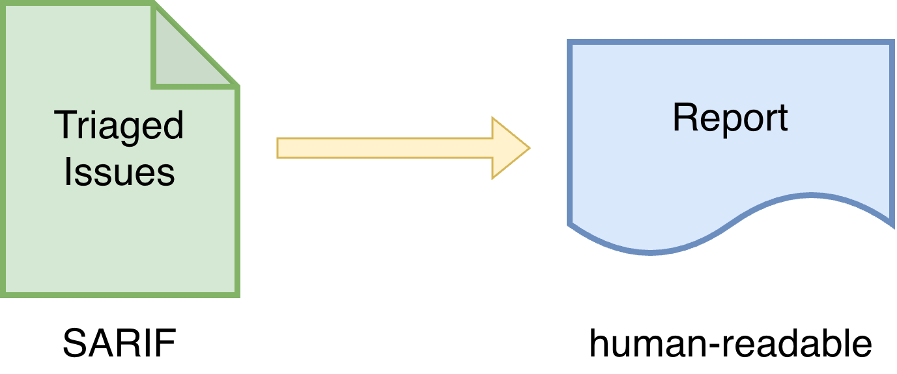
Report
Notes:
Script:
Now let's take a moment to talk about the report.
At this point, we've triaged the results of the scan and identified those issues which need further attention.
Either they're going into the threat prioritization process, or directly to issue tracking.
We've also identified those outputs from the scan which are false positives and need to be dealt with.
The results of the triage now need to be put into a human readable form.
When we're talking about the issues, we're going to be encoding those, ideally, in SARIF, because that gives us this common way to move things through the CI/CD pipeline.
The report will cover the element, the particular deprecated functions found, and where they are within the element.
It will be grouped to show the issues that we need to address followed by those we're not going to address.
This will be covered in detail in the triage activity material.
It's also addressed in the Report Generation elaboration material.

Slide 18
Recap
Notes:
Script:
That's an overview of the process used in handling deprecated functions.
Now let's review what's been covered.

Slide 19
Summary
Identify the functions
Incorporate into the pipeline
Scan the source
Triage the results
Start small and expand
Report the findings
Notes:
Script:
Stepping through our process, we want to
[pause]
identify the deprecated functions.
[pause]
Incorporate scanning into the pipeline for particular elements.
[pause]
Next, we want to scan the source code for the deprecated functions.
[pause]
And triage the results.
The thing to keep in mind here is that you want to
[pause]
start small and expand, as with all things we do within the context of cybersecurity.
Also, and most importantly, we want to
[pause]
report the findings, because that's the goal of this particular activity.
Further Reading
For more information, and to get a more in-depth set of references, the Currently Used Deprecated Functions Document secondary document is available in the AVCDL GitHub repository.
AVCDL on GitHub
All AVCDL materials, both in source and distribution forms, are available on our GitHub site, as shown here.
Because of the size of the repository, it's recommended that you either clone the repository or download a ZIP archive of it, if you're not familiar with using git.
Instructions for downloading a ZIP archive are linked to on the repository’s front page.
AVCDL on YouTube
Videos covering various aspects of the AVCDL are available on our YouTube channel, as shown here.
It's important to note that all AVCDL materials except for the introductory blog posts are intended for product cybersecurity engineering practitioners.

Slide 20
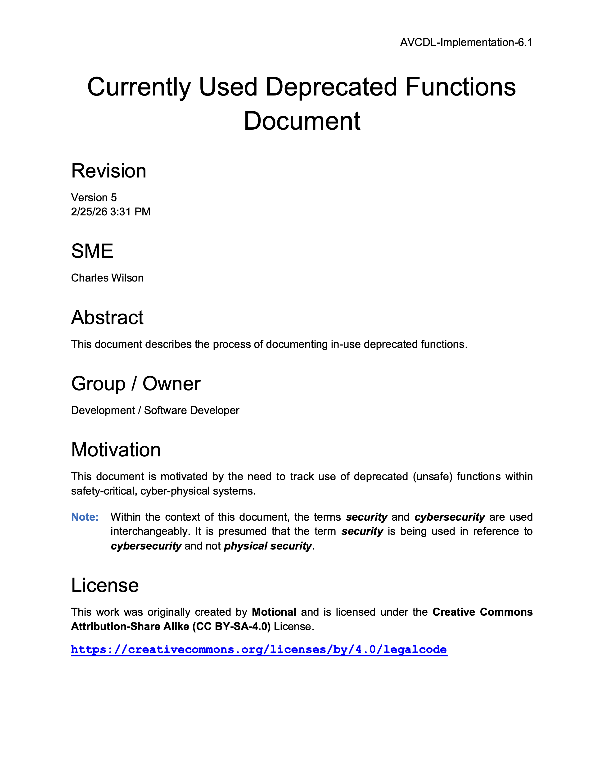
Further Reading
Notes:
Script:
For more information, and to get a more in-depth set of references, the Currently Used Deprecated Functions Document secondary document is available in the AVCDL GitHub repository.

Slide 21
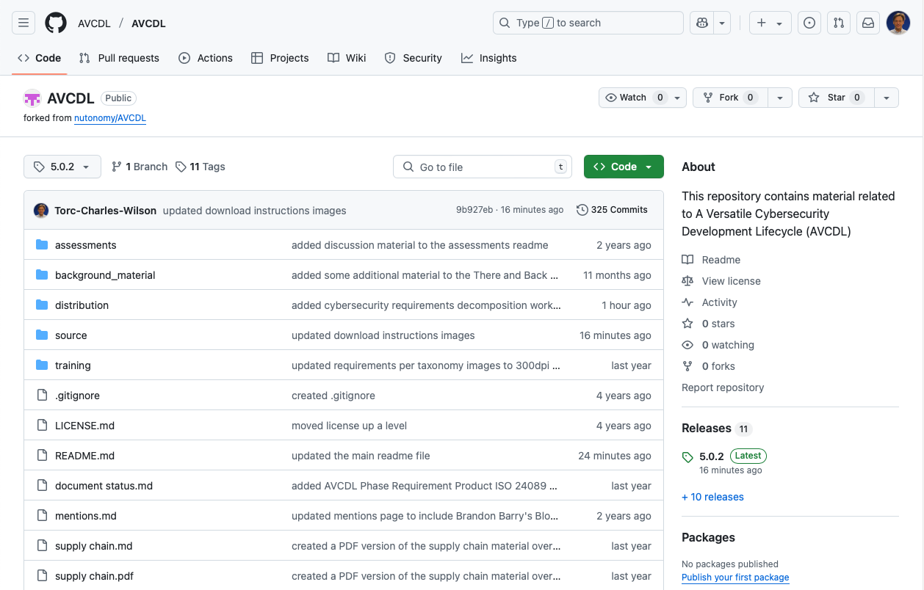
AVCDL on GitHub
https://github.com/AVCDL/AVCDL
Notes:
Script:
All AVCDL materials, both in source and distribution forms, are available on our GitHub site, as shown here.
Because of the size of the repository, it's recommended that you either clone the repository or download a ZIP archive of it, if you're not familiar with using git.
Instructions for downloading a ZIP archive are linked to on the repository’s front page.

Slide 22
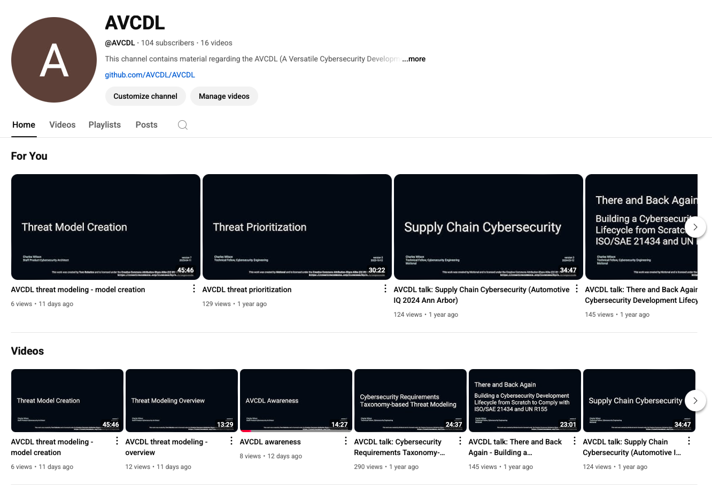
AVCDL on YouTube
https://youtube.com/@AVCDL
Notes:
Script:
Videos covering various aspects of the AVCDL are available on our YouTube channel, as shown here.
It's important to note that all AVCDL materials with the exception of the introductory blog posts are intended for product cybersecurity engineering practitioners.

Slide 23
Next Steps
Notes:
Script:
With this training complete, once you’ve completed the other deprecated functions trainings, you can proceed to the other trainings at this level, these include:
Code Reuse
and
Secure Coding

Slide 24
References
Currently Used Deprecated Functions Document (AVCDL secondary document)
Threat Prioritization Plan (AVCDL secondary document)
Report Generation (AVCDL elaboration document)
Static Analysis Results Interchange Format (SARIF) Version 2.1.0
https://docs.oasis-open.org/sarif/sarif/v2.1.0/os/sarif-v2.1.0-os.pdf
Square edge razor (unattributed) [CC BY-SA 3.0]
https://creativecommons.org/licenses/by-sa/3.0/
https://commons.wikimedia.org/wiki/File:Square_edge_razor.JPG
Oscillating electric razon (Bill Ebbesen) [public domain]
https://commons.wikimedia.org/wiki/File:Oscillating_electric_razor.jpg
Notes:
Script:
Here are the references to the source material used in the creation of this presentation.
They'll also be included in the video description.
Additionally, this presentation’s source material will be provided on the AVCDL GitHub repository.

